Slide 1
“UDS 3.0” – JSON Concept Overview
Nate Jennings - Software Engineering Manager
Mike Ulmer - VP-Technology Services and Operations

Slide 2
Current Challenges – Survey Results
Readability and Rigid Structure
  Difficult to read, edit and keep things straight when editing
Key data elements missing from the UDS standards
  Contact information (Email, mobile phone)
  Property address vs owner address
  Other
Fixed length field limitations
  Longer names – growing trend
Validation Challenges
  Requires custom programming

Slide 3
Possible Solutions: Pros and Cons
 | Pros | Cons
#1. Expand current fixed-length record structures | Could address concerns of today, possibly static for years to come | Expensive to modify system import/export functionality Doesn’t address readability/edit issues Documentation updates
#2. Adopt flexible, hierarchical transport structure (JSON) | Easy to adapt as needs change. Human readable, easy to edit. Easy to convert back-and-forth to flat file. Validation via JSON schema | Initial learning curve and expense to create conversion programs Vendors may not (yet) support File length, “extra” characters
#3. Status Quo (no change) | Doesn’t solve problem | No cost to implement ☺

Slide 4
Introducing JSON (Javascript Object Notation)
UDS A Record (partial):
{
"record_type": “A”,
"Insolvent_company_number": “55555”,
"file_location_state": “AZ”,
"file_location_code": “10”,
"coverage_code": “575005”,
"policy_number": “88888”,
"insolvent_company_claim_number": “9999999”,
"receiver_claim_number": “12345-678”,
"insured_first_name": “John”,
"insured_last_name": “Doe”
}
Benefits of JSON
Hierarchical Data
Schema Flexibility
Order independent
Readability
Wide Adoption

Slide 5
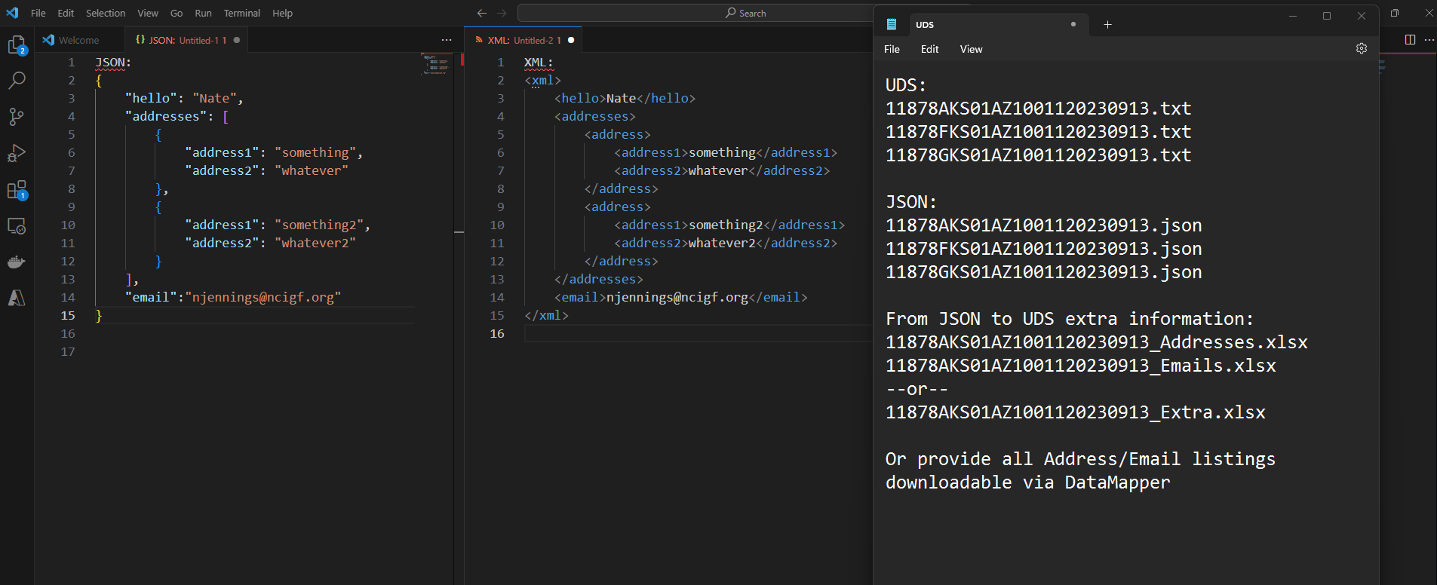

Introducing JSON (Javascript Object Notation)
JSON Syntax Example:

Slide 6
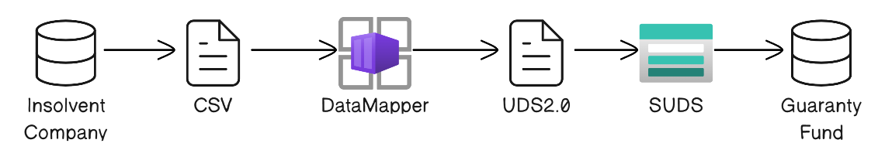
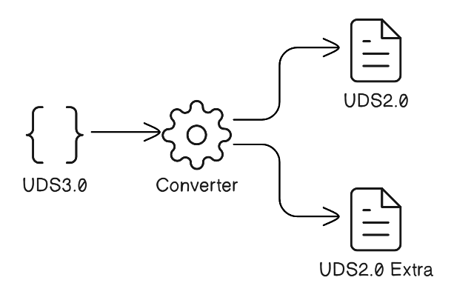
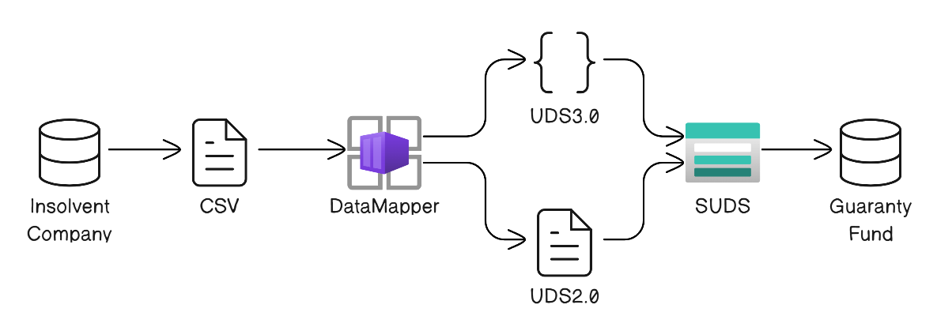
JSON for UDS Data Interchange
CURRENT
CONVERSION UTILITY
PROPOSED
UDS 3.0 option – “extra” fields contained in JSON
UDS 2.0 option -Deliver “extra” data in separate files, use or discard at discretion of recipient

Slide 7
Proposed Next Steps
UDS 3.0 Subcommittee
Work together to build JSON Schema
Present to ___ for approval (?)
NCIGF
Add support for JSON to UDS Data Mapper
Build UDS 2/3 conversion tool
?

